Slide 1
Alta Performance com Java
Java OO com Alta Performance

Slide 2
Apresentação
Atuo na área de TI desde 1996 e com Java e aplicações corporativas desde 2004. Tive a oportunidade de participar de grandes projetos para clientes como: HP, EDS, Bosch, Mitsubhishi e para os Governos de Santa Catarina, São Paulo e Mato Grosso do Sul. Atualmente me encontro imerso na cultura Ágil e palestrando em importantes eventos como Javaneiros e Flisol.
@apedrina
pedrina.alisson@gmail.com
www.alissonpedrina.wordpress.com

Slide 3
O curso
Como nasceu a ideia
Como evoluiu
Para onde vai

Slide 4
Conteúdo
A Tecnologia Java
História do Java
Java na atualidade
Java e mercado de trabalho
Como surfar a atual onda
Performance
Arquitetura da JVM
Modelo de Memória
Garbage Collector
Classloader

Slide 5
Conteúdo
JIT
Engine de execução
JDK Tools
MAT e GCMV
Usando a memória
Microbenchmark
Web Performance
Agent
AOP
Manifesto Ágil
Scrum
XP
Clean code

Slide 6
The Java Technology

Slide 7

What is?
Language
Plataform
JVM

Slide 8
History of Java Technology
http://www.javatpoint.com/history-of-java

Slide 9
Green Team
James Gosling, Mike Sheridan, and Patrick Naughton initiated the Java language project in June 1991. The small team of sun engineers called Green Team.
Originally designed for small, embedded systems in electronic appliances like set-top boxes.
Firstly, it was called "Greentalk" by James Gosling and file extension was .gt.
After that, it was called Oak and was developed as a part of the Green project.

Slide 10
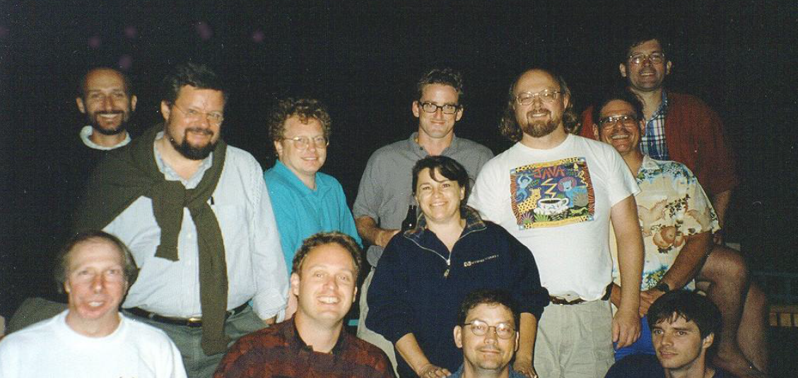
Green Team

Slide 11
Why OAK?
Oak is a symbol of strength and choosen as a national tree of many countries like U.S.A., France, Germany, Romania etc.
In 1995, Oak was renamed as "Java" because it was already a trademark by Oak Technologies.

Slide 12
Why Java?
The team gathered to choose a new name. The suggested words were "dynamic", "revolutionary", "Silk", "jolt", "DNA" etc. They wanted something that reflected the essence of the technology: revolutionary, dynamic, lively, cool, unique, and easy to spell and fun to say.
According to James Gosling "Java was one of the top choices along with Silk". Since java was so unique, most of the team members preferred java.
Java is an island of Indonesia where first coffee was produced (called java coffee).
Originally developed by James Gosling at Sun Microsystems (which is now a subsidiary of Oracle Corporation) and released in 1995.

Slide 13
Versions
JDK Alpha and Beta (1995)
JDK 1.0 (January 23, 1996) | Oak
JDK 1.1 (February 19, 1997)
J2SE 1.2 (December 8, 1998) | Playground
J2SE 1.3 (May 8, 2000) | Kestrel (hotspot)
J2SE 1.4 (February 6, 2002) | Merlin (jcp) jsr59
J2SE 5.0 (September 30, 2004) | Tiger
Java SE 6 (December 11, 2006) | Mustang
Oracle 2010
Java SE 7 (July 28, 2011) | Dolphin
Java SE 8 (March 18, 2014)

Slide 14
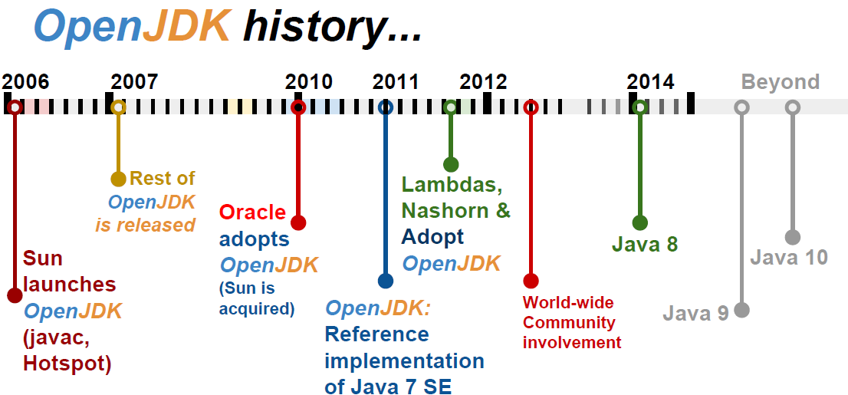
To promote and support community involvement in the development, adoption and evangelism of OpenJDK projects

Slide 15
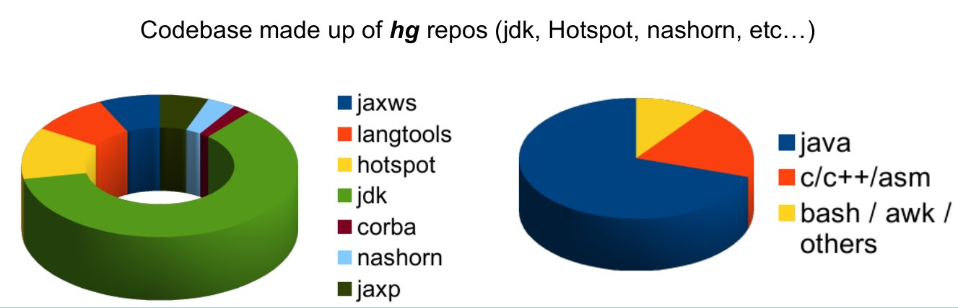
Codebase OpenJdk

Slide 16
Nowadays
Java now !!!

Slide 17
JCP and JSR
Welcome to jcp.org, home of the Java Community ProcessSM (JCPSM) Program. The JCP is the mechanism for developing standard technical specifications for Java technology. Anyone can register for the site and participate in reviewing and providing feedback for the Java Specification Requests (JSRs), and anyone can sign up to become a JCP Member and then participate on the Expert Group of a JSR or even submit their own JSR Proposals.

Slide 18
JDK Enhancement Proposal
The JDK Enhancement Proposal (or JEP) is a process drafted by Oracle Corporation for collecting proposals for enhancements to the Java Development Kit and OpenDK.

Slide 19
Meta-circular and dynamics languages
Maxine - JVM
Graal VM – compilador e interpretador
Jruby
Jython
Nashorn
Scala
Groovy

Slide 20
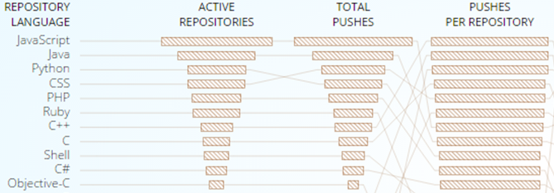
GitHub

Slide 21
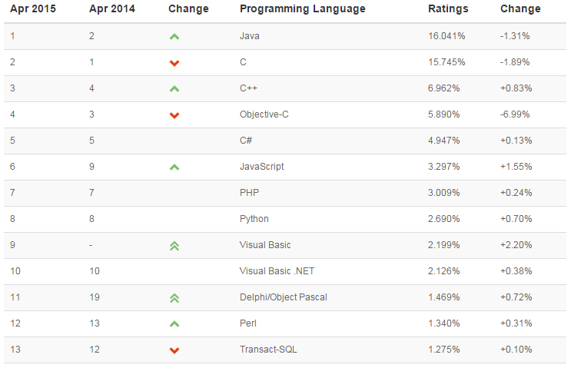
TIOB TIOBE checks more than 300 million lines of software code for its customers world-wide, real-time, each day.

Slide 22
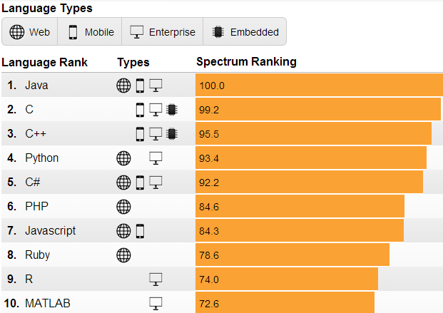
IEEE is the world's largest professional association dedicated to advancing technological innovation and excellence for the benefit of humanity.

Slide 23
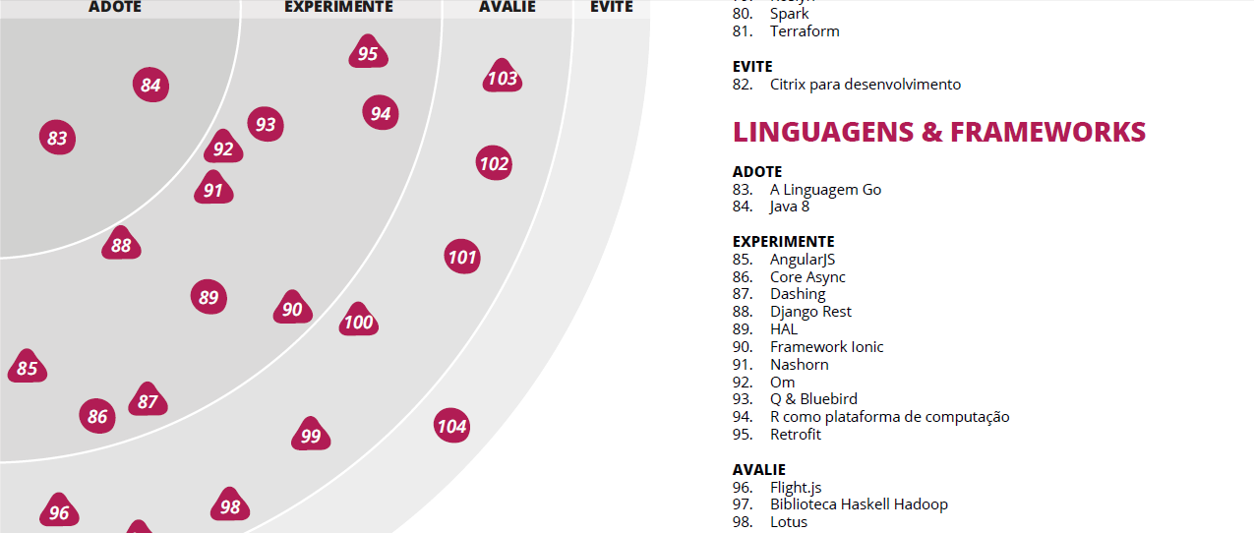
Radar thoughtworks

Slide 24
Job market
In Brasil and in the world

Slide 25
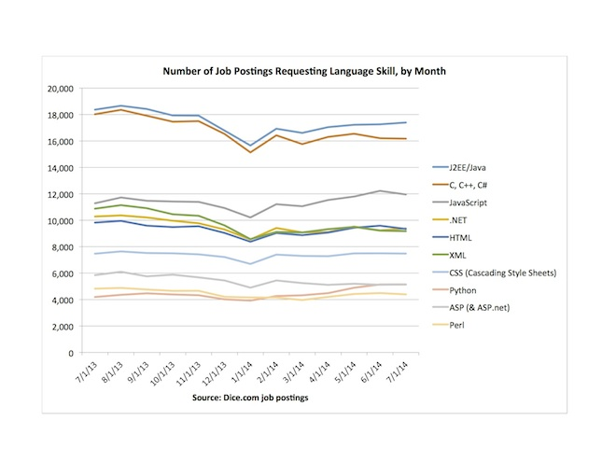
Dice.com

Slide 26
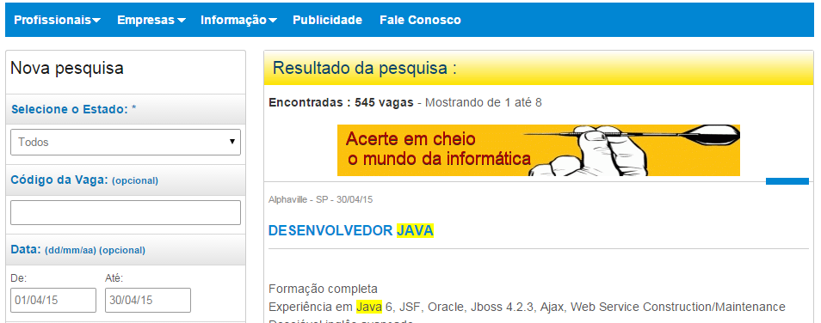
www.apinfo.com

Slide 27












Some companies

Slide 28
How to surf current wave

Slide 29
This makes the differences
Solid principles OO
Design Patterns
S.O.L.I.D
Clean code
Automated Testing
TDD
Agile manifesto

Slide 30
Performance

Slide 31

What is?
Performance scalability bottleneck

Slide 32



When testing?
Early
Afternoon
Balanced

Slide 33
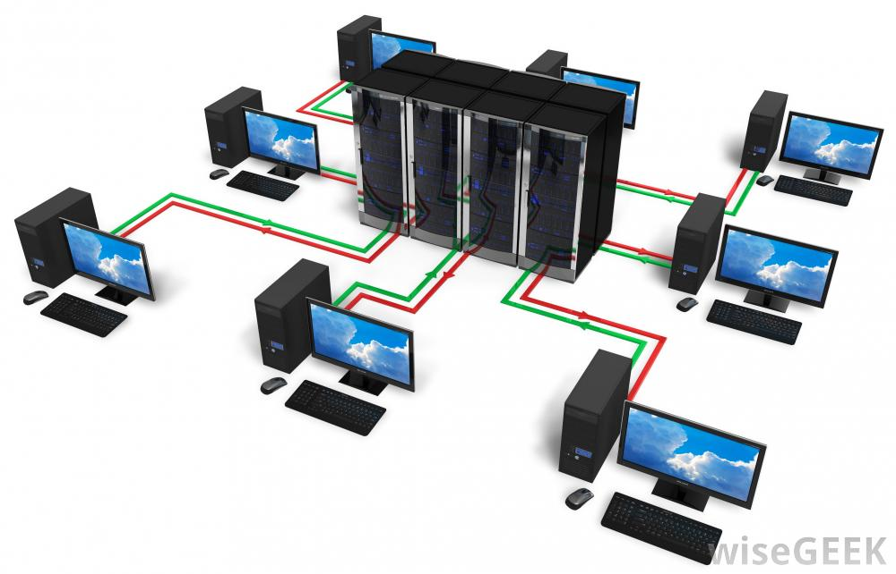

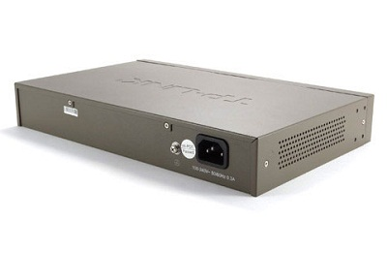
Where is bottleneck?

Slide 34
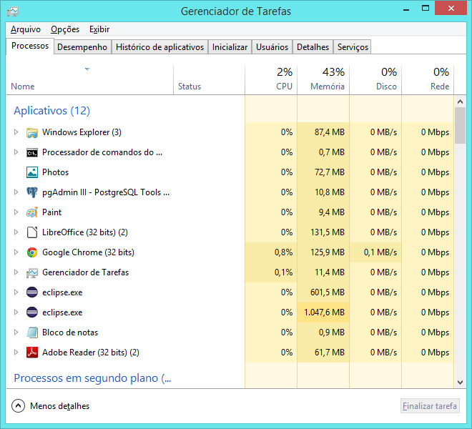
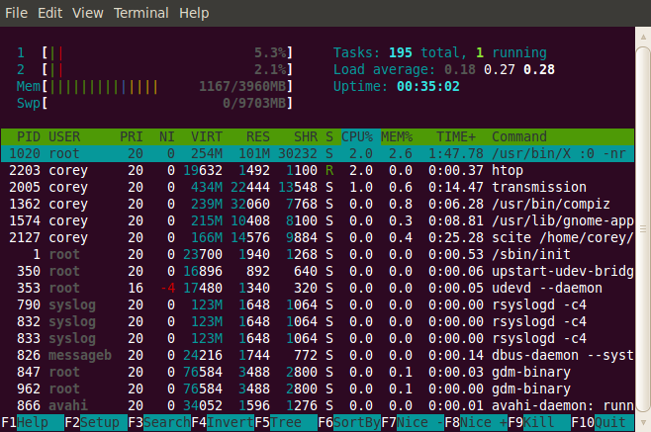
Tools

Slide 35
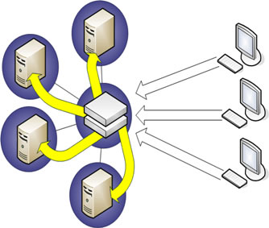
Tests
Real applications
Exact copy
Subsystems
Regression testing

Slide 36

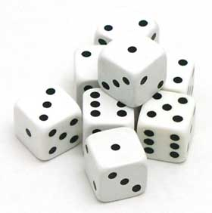
Which helps
Queuing theory
Probability

Slide 37
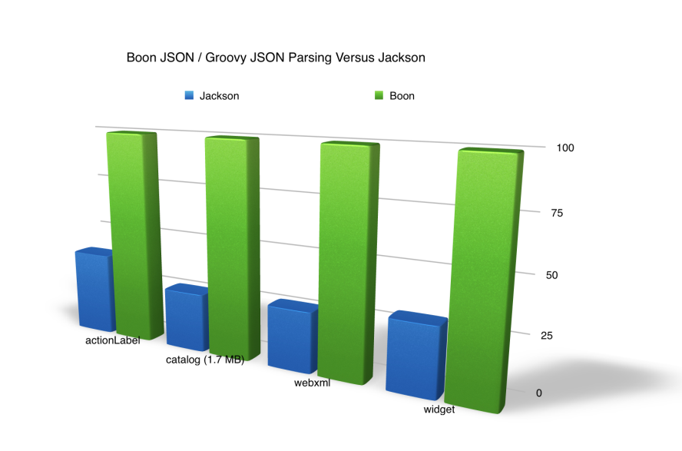
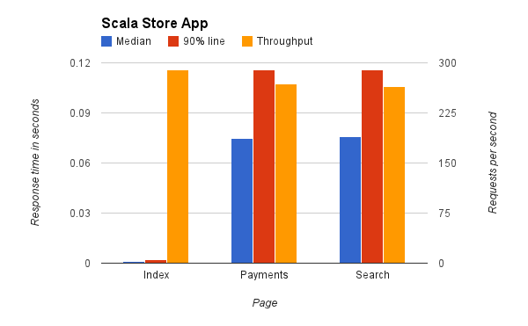
Benchmark
Microbenchmark
Macrobenchmark
Mesobenchmark

Slide 38
Which mesuare
Response Time
Batching
Latency
Throughput
Scalability
Stress Testing

Slide 39
Stress Testing
if you find yourself running tests for more than 24 hours you are doing a stress test.

Slide 40
Scalability
is the measure of how your system responds when additional hardware is added.

Slide 41
Throughput
transactions per second your application can handle (motivation / result of load testing). A typical enterprise application will have lots of users performing lots of different transactions. You should ensure that your application meets the required capacity of enterprise before it hits production.
Throughput
OPS/TPS /RPS and average time
Ex: 500ops at 0.5s x 400ops at 0.4s

Slide 42
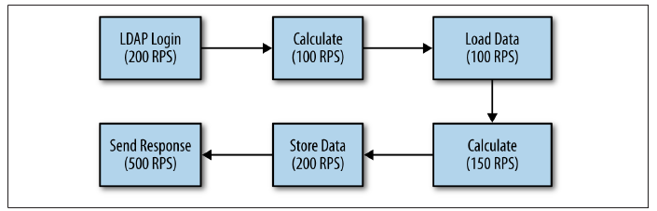
What is that?

Slide 43
Response Time
Amount of time system takes to process a request after it has received one. For instance you have API and you want to find how much time that API takes to execute once invoked, you are in fact measuring response time.
Think time
Média tempos somados dividido pelo número de request
Porcentagem 90%, 5%, etc

Slide 44
Latency
In simplest terms this is Remote Response time. For instance, you want to invoke a web service or access a web page. Apart from the processing time that is needed on the server to process your request, there is a delay involved for your request to reach to server. While referring to Latency, it’s that delay we are talking about.
Networking virtualization

Slide 45
Tips
Variability
Probability
Do not sacrifice solide principles of architecture in exchange for performance
Try to create good programs rather than fast, unless…

Slide 46
JVM Architectura

Slide 47
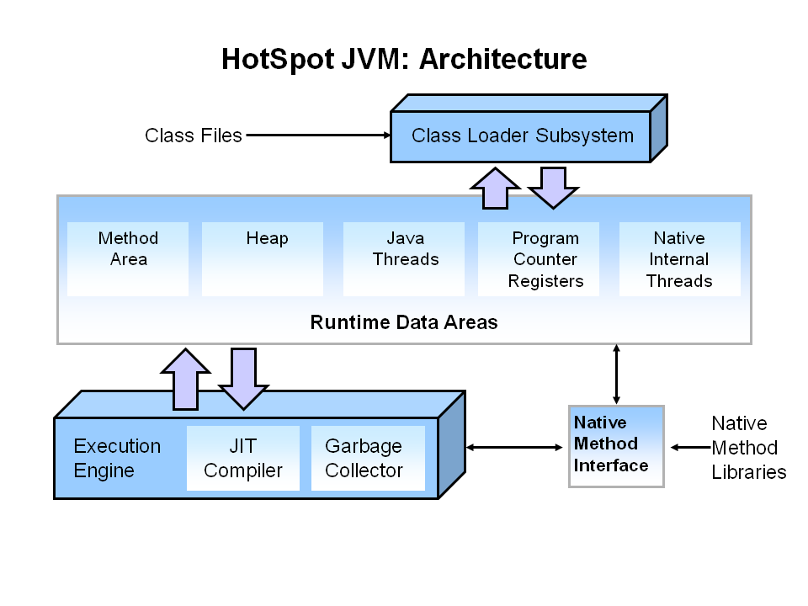
Overview

Slide 48
Memory model

Slide 49
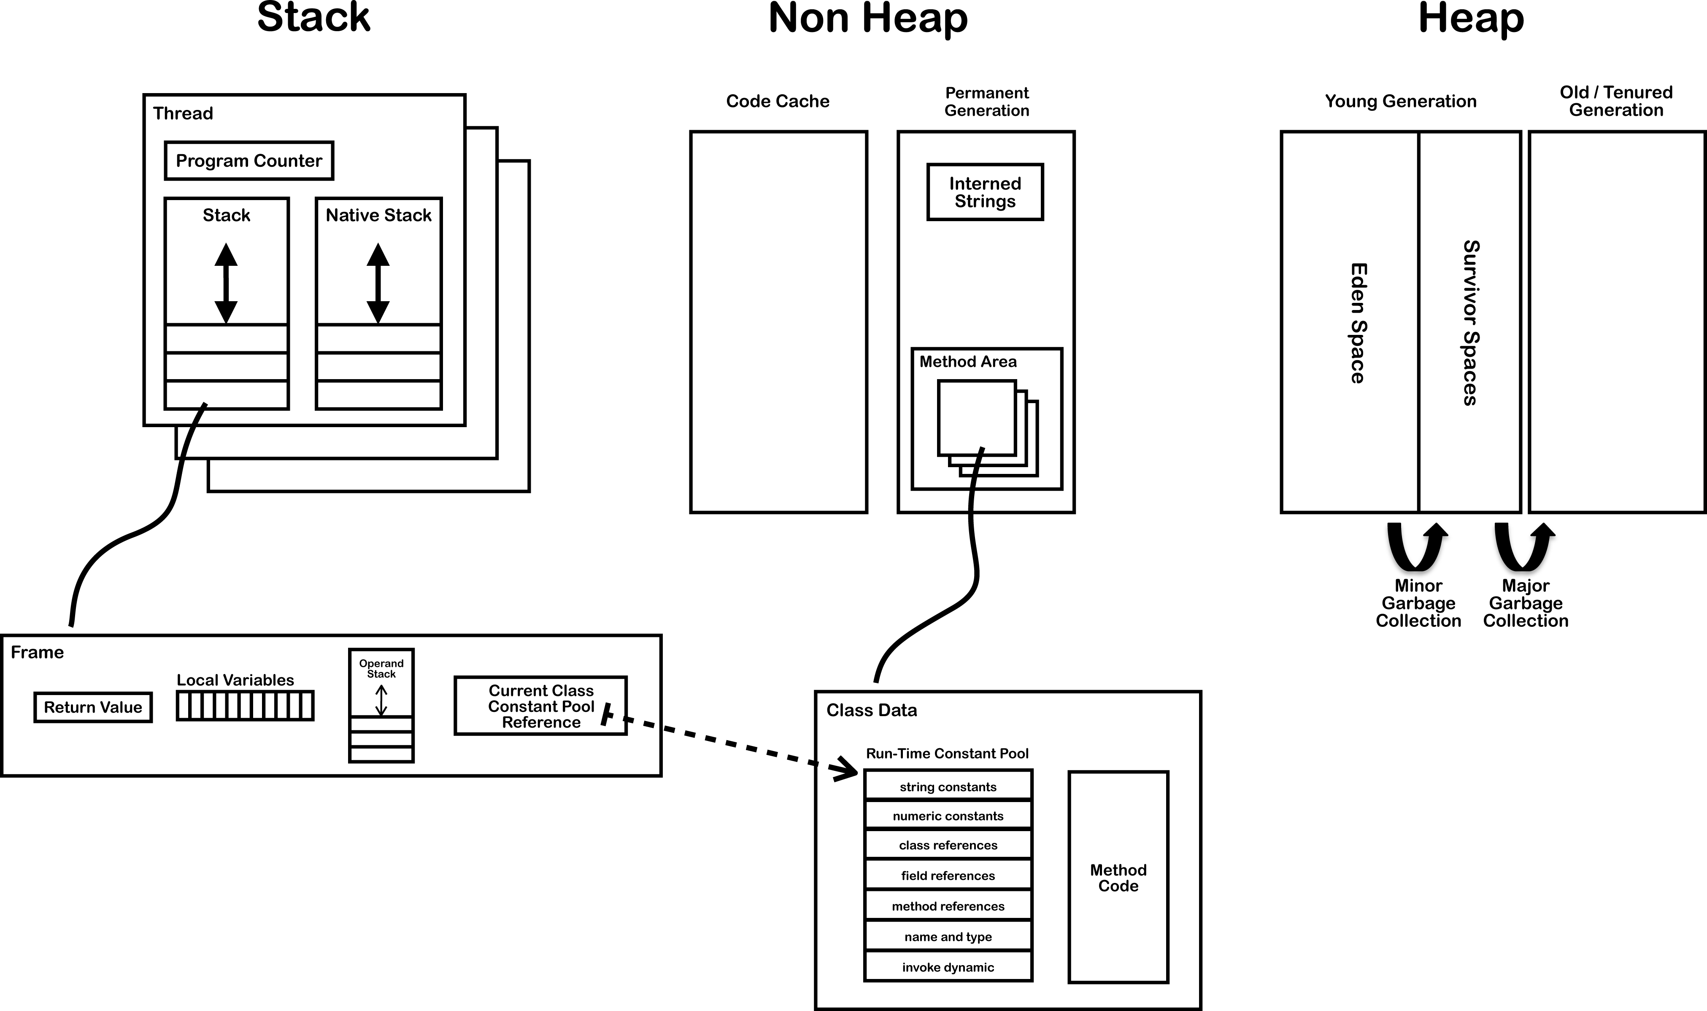
Modelo de memória

Slide 50
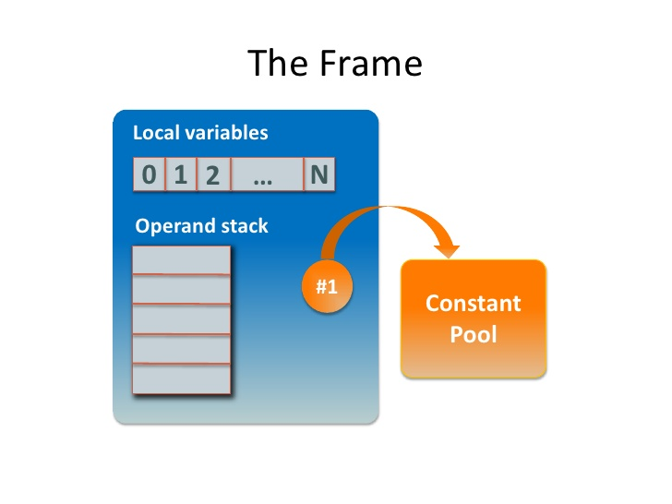

Slide 51
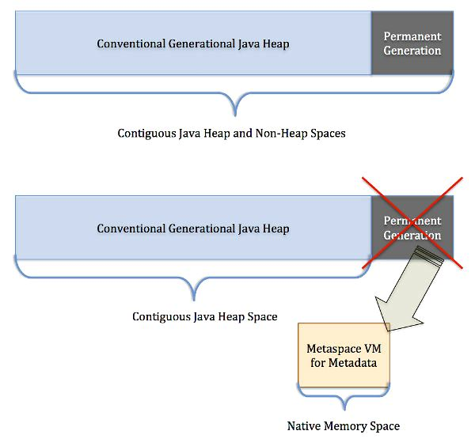

Slide 52
Out of memory errors
No native memory is available for the JVM.
The permgen (in Java 7 and earlier) or metaspace (in Java 8) is out of memory.
The Java heap itself is out of memory: the application has too many live objects for
the given heap size.
The JVM is spending too much time performing GC.

Slide 53
Flags that can help
-XX:+HeapDumpOnOutOfMemoryError
-XX:HeapDumpPath=<path>
-XX:+HeapDumpAfterFullGC
-XX:+HeapDumpBeforeFullGC
-XX:GCTimeLimit=N (default 98%)
-XX:GCHeapFreeLimit=N (default is 2%)
-XX:+UseGCOverheadLimit (default is true)

Slide 54
Garbage Collector

Slide 55
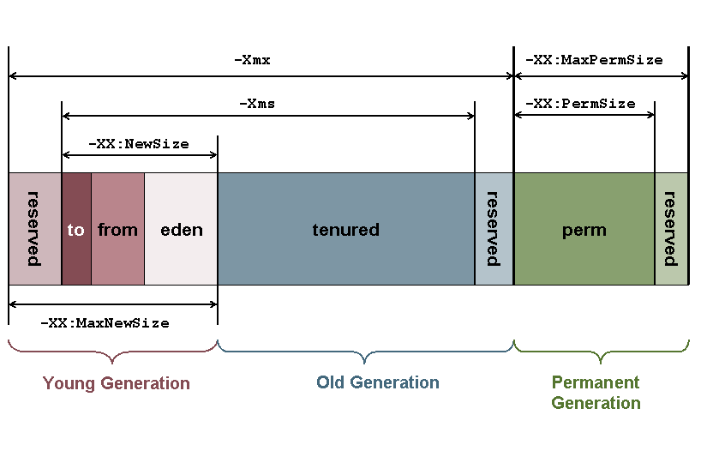
Garbage Collector

Slide 56
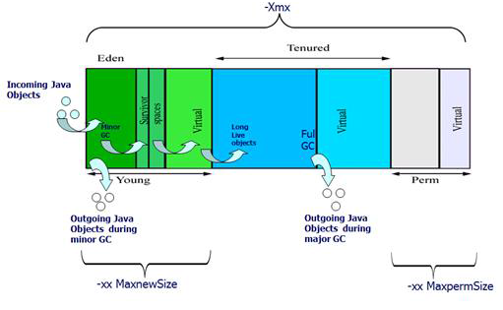

Slide 57
Kinds of GC
-XX:+UseSerialGC
-XX:+UseParallelGC
-XX:+UseConcMarkSweepGC
-XX:+UseG1GC

Slide 58
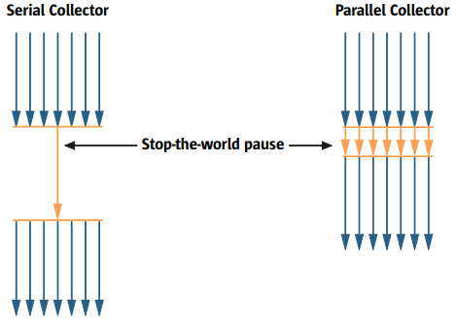

Slide 59
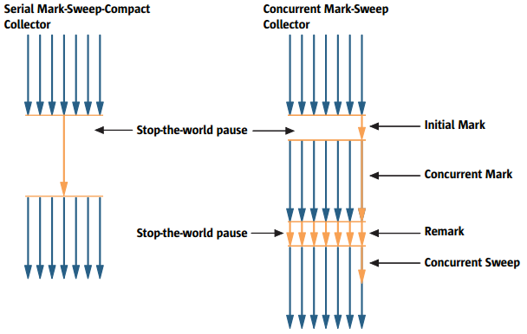

Slide 60
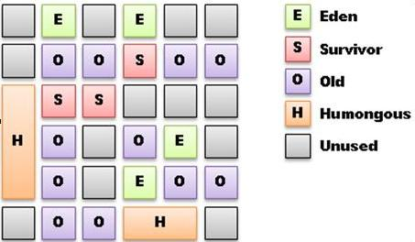
G1

Slide 61
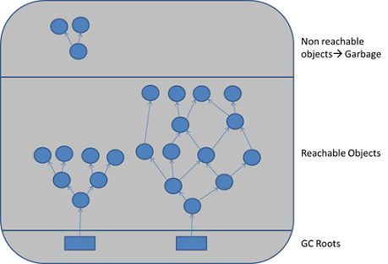
Java threads, jni references, static and local variables

Slide 62
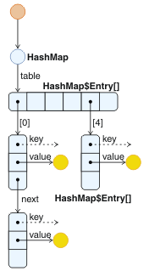

Slide 63
Size of Java instances variables
byte 1
char 2
short 2
int 4
float 4
long 8
double 8
reference 4 on 32-bit JVMs and 64-bit JVMs with heaps of less than 32 GB;
8 on 64-bit JVMs with large heaps

Slide 64
How much memory hold a object?
Shallow size
Deep size
Retained size

Slide 65
Compressed OOPS
32 or 64 bits?
32 bits for Heap at least 4GB (3.5 in pratice)

Slide 66
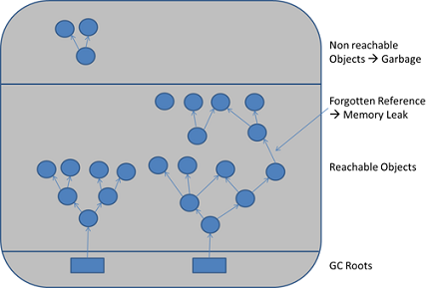
Memory leak

Slide 67
Flags
You need at least: – -XX:+PrintGCTimeStamps
Add -XX:+PrintGCDateStamps if you must know the time
– -XX:+PrintGCDetails
Preferred over -verbosegc as it's more detailed
Also useful: – -Xloggc:<file>
– Rotate GC Log, After Java 1.6_34 (or 1.7_2):
-XX:+UseGCLogFileRotation
-XX:NumberOfGCLogFiles=5
-XX:GCLogFileSize=10M

Slide 68
Classloader

Slide 69
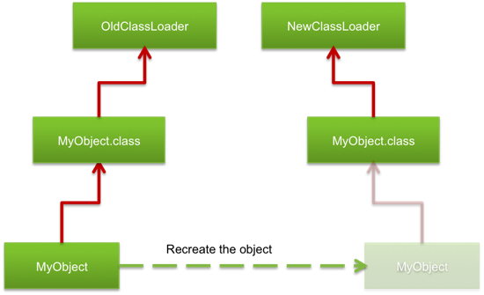
Learn about OutOfMemory and Classloader

Slide 70
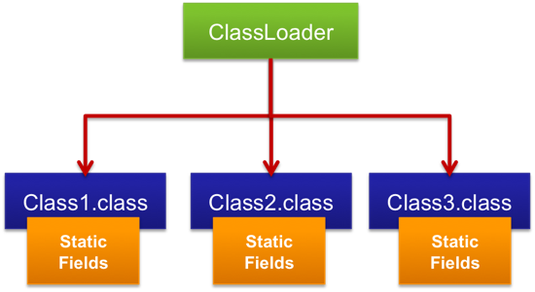
Retained

Slide 71
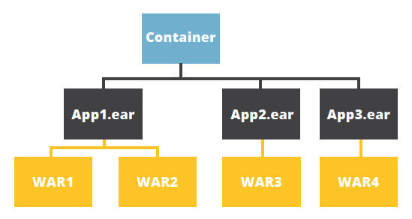
Java EE delegation model

Slide 72
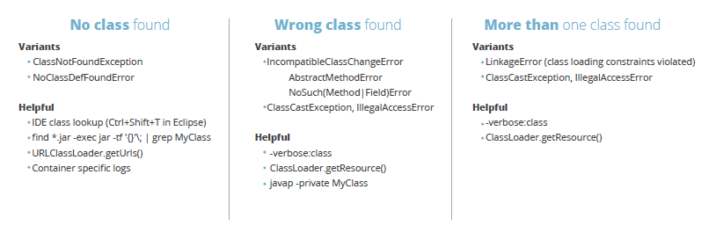
Errors and possible solutions

Slide 73
JIT

Slide 74
JIT.pdf
See the JIT.pdf in doc directory

Slide 75
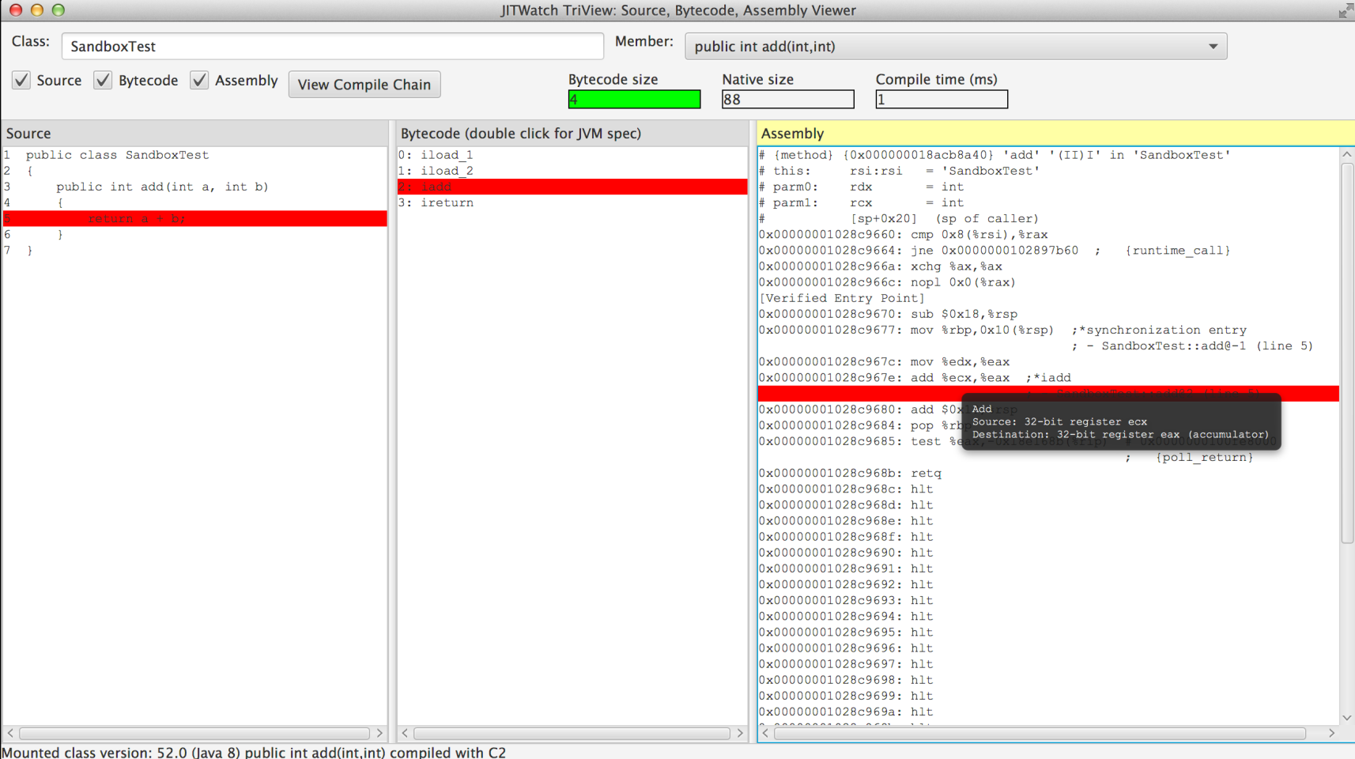
JITWatch

Slide 76
Execution engine

Slide 77
Bytecode
See the JVM_For_Dummies.pdf

Slide 78
The jdk tools

Slide 79
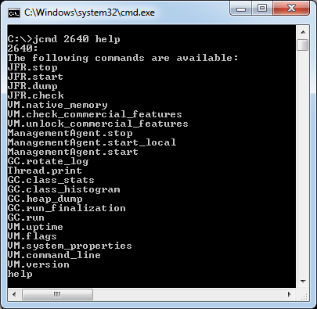
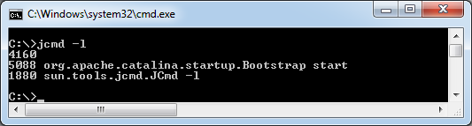
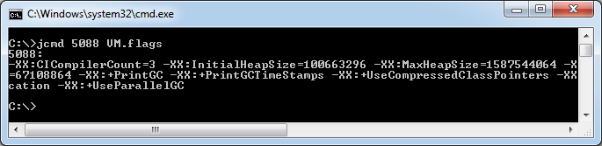
jcmd

Slide 80
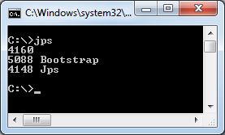
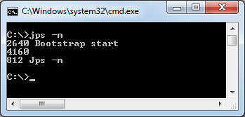
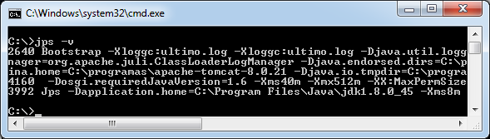
JPS

Slide 81
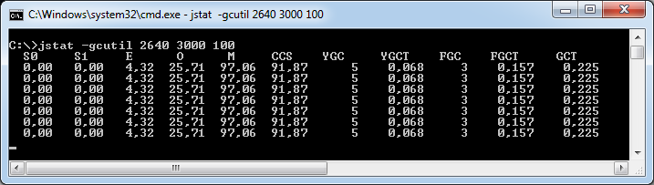
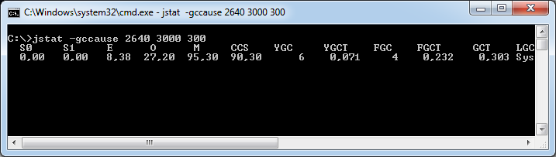
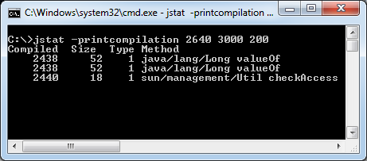
jstat

Slide 82
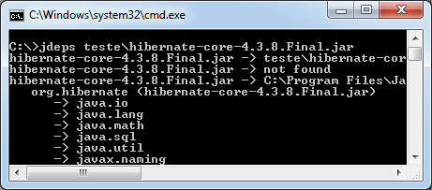
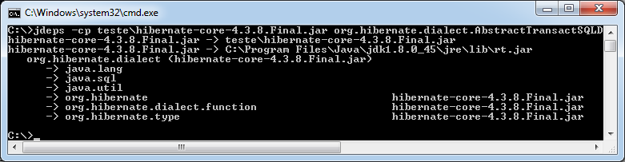
jdeps

Slide 83
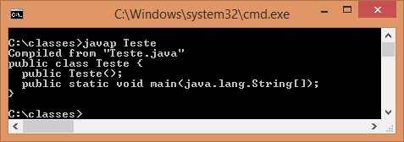
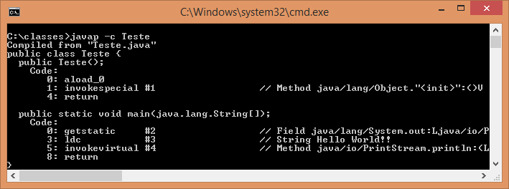
javap

Slide 84
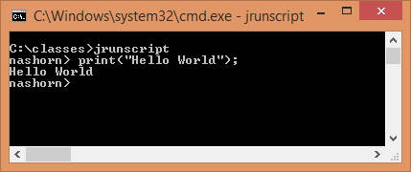
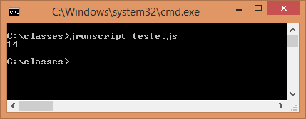
jrunscript

Slide 85


jjs

Slide 86

jconsole

Slide 87

jvisualvm

Slide 88
JVM Flags

Slide 89
GC
-XX:NewSize and -XX:MaxNewSize
-XX:NewRatio
-XX:SurvivorRatio

Slide 90
MAT and GCMV

Slide 91

Memory Anlyzer Tool

Slide 92

https://www.ibm.com/developerworks/java/jdk/tools/gcmv/#download

Slide 93
Using memory

Slide 94
References
Strong
Weak
Soft
Phanton

Slide 95

Weak

Slide 96

Soft
-XX:SoftRefLRUPolicyMSPerMB=<N>

Slide 97

Soft

Slide 98

Phantom

Slide 99

Finalize - Guardian

Slide 100

FileInputStream

Slide 101

Chain of finalazers

Slide 102
Method factory /Flyweight

Slide 103

No instanciable classes
Math
Arrays
Collections

Slide 104

Lazy initialization

Slide 105

Singleton

Slide 106

Singleton enum

Slide 107

Thread local

Slide 108

String

Slide 109
Micro benchmark
JMH

Slide 110
Examples on JMH
https://github.com/apedrina/altaperformance.git
Jmh project

Slide 111
Application Web performance

Slide 112
Tips
Compress the output
Combine CSS and JS resources
Produce less whitspace
-Xss – thread stack size

Slide 113
Agent

Slide 114
Github
Agent project

Slide 115
Aop

Slide 116
github
Aop project

Slide 117
EJB / RMI

Slide 118
Arquitetura
DDD e SOA

Slide 119

Three layers

Slide 120

BoundedContext

Slide 121

Events and jms

Slide 122

Where is the microservices?

Slide 123
Agile manifesto

Slide 124


Slide 125
Scrum

Slide 126


Slide 127
XP

Slide 128
Practices
TDD
Pair Programming
Continuous integration

Slide 129
Clean code

